Slide 1
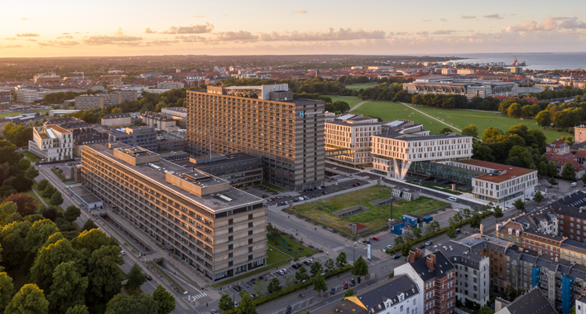
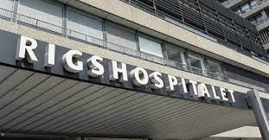
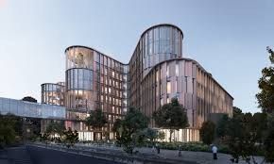
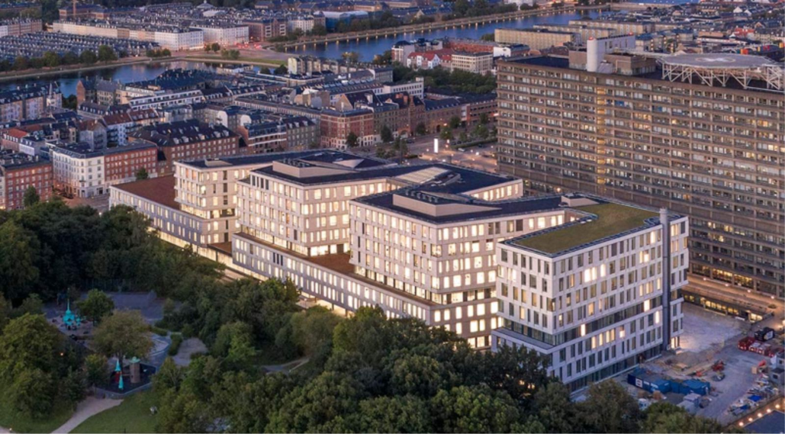
A system dynamics analysis about the relationship between ventilation and the spread of COVID-19 in indoor spaces
Work in progress
Daniel A. Sepulveda-Estay, PhD
Christian M. Sørup, PhD
Copenhagen University Hospital, Denmark
Notes:
Hello and Welcome to this presentation about our ongoing work exploring the relationship between ventilation and the spread of airborne pathogens through the use of a system dynamics model, and applied to the covid19 pandemic.

Slide 2
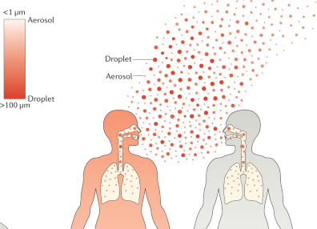
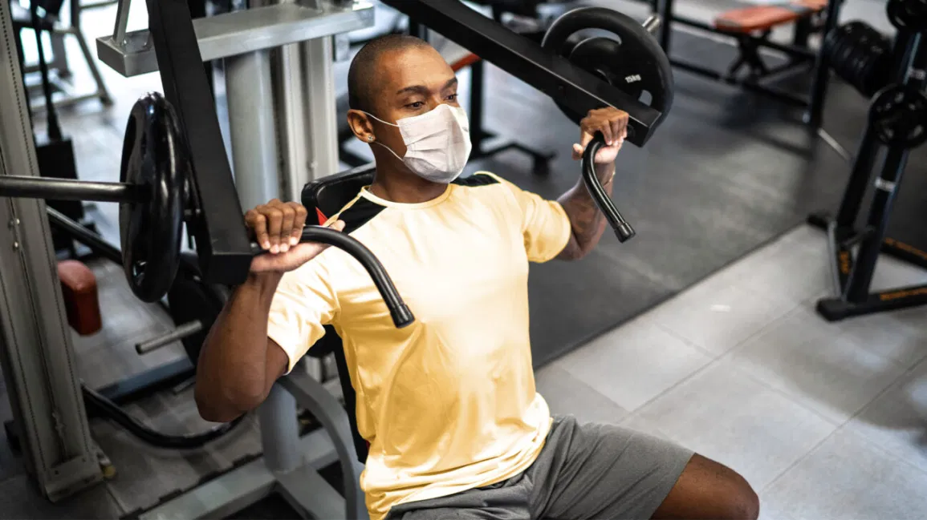
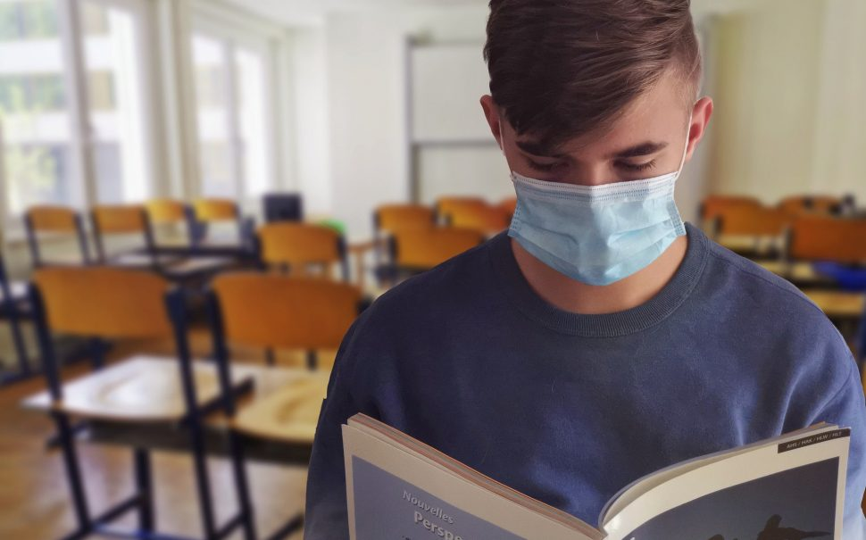
Project Case
COVID-19 is transmissible through air
Transmissibility is also dependent on viral concentration in air
Principal policy focus so far on:
Distance guidelines (density, absolute distance)
Personal air filters (masks)
Generic ventilation guidelines
Ventilation has an effect on air viral concentration
Opportunity for:
Scenario testing for different indoor environments
Activity-dependent ventilation (e.g., Restaurants, Classrooms)
Identification of Operational recommendations
Ventilation System Characteristics (Q, pf, RH)
Activity type and duration (e.g., number and length of school breaks)
Notes:
The case is based on increasing evidence that COVID-19 is transmissible through air,
Additionally, airborn pathogen transmissibility is dependent on viral concentration in the air.
However, policy focus with respect to ventilation has been on
distance guidelines such as number of people in a room or indications like the 2 meter rule,
the use of masks and
generic ventilation guidelines
Ventilation can have an effect on airborne viral concentration
Given that Ventilation has an effect on viral concentration
there is an opportunity to
test scenarios for different indoor environments
in order to explore the possibility of activity based ventilation, as the needs would not be the same for a school and restaurant, for example
this scenario testing could identify ventialtion system requirements such as air flow, required filter efficiency or relative humidity)
or could indicate suitable activity types and durations for existing ventilation systems.

Slide 3



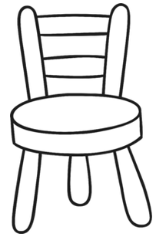
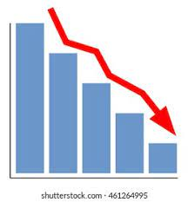
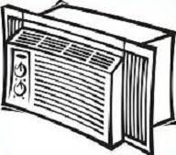
What is the relationship between transmission and ventilation?
Contact between susceptible and virus
Susceptible
Population
Infected
Population
Virus Production
Vicious Cycle of virus production and infection
Infected
Virus Concentration in the room
time
Virus lost due to filters and air exchange
Ventilation System
Virus lost due to settling and deactivation
Notes:
The first question we attempt to answer when developing this model is to understand the physics of the problem.
There is a susceptibnle population which comes in contact with vira in the air within a room, and eventually becomes infected.
This infected population become producers of vira which continue to accumulate in the room. This increases the density of vira in the room resulting in the infection of other susceptibles,
Creating a vicious cycle ofvirus production and infection.
Now consider a ventilation system
This ventilation system recirculates the air in the room, exchanging some of the air for freshe ouside air, losing in the process viral particles. Additionally, due to gravity, ventilation currents and deactivation, vira could be lost due to them settling on surfaces or becoming inactive.

Slide 4
Dynamic Hypothesis
The level of ventilation used is inversly proportional to transmission rate:
Ventilation level
Transmission Rate
Time
Time
Notes:
Our Dynamic Hypothesis expects that higher ventilation levels will result in a lower transmission rate.

Slide 5
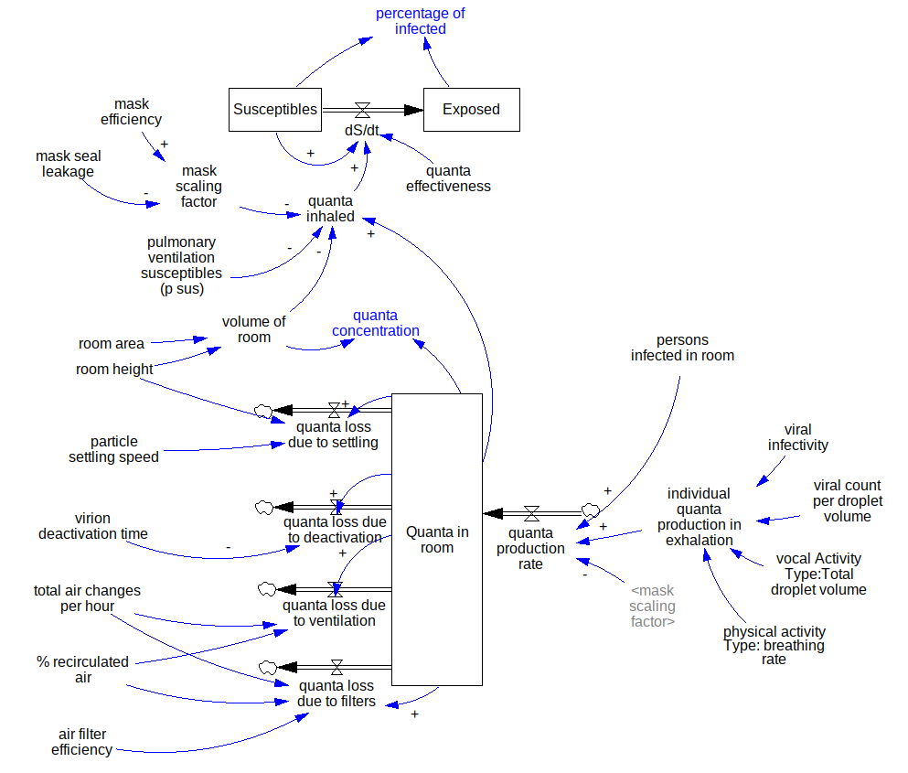
Notes:
The model is based on a basic SE model with stocks for both susceptible and Exposed populations,
and a flow rate from Susceptibles to Exposed dependent on the Number vira inhaled, represented by quanta, a measure of viral concentration and infectivity, and the contragion effectiveness of these quanta.
It is worth noting that in our model, the exposed population does not become infective, but rather there is an exogenous variable representing the infective persons in the room.
The infected in the room, producxe infective quanta at a rate based on the individual quanta production that takes into consideration things like the infectivity of the pathogen, the vocal activity of the infected from whispering to singing loudly, and the physical activity of the infected, from sitting down to doing intense exercise.
These quanta accumulate in the room and is refected in the model as a stock, and has a direct effect on the quanta inhaled, closing the cycle of infection-and virus production.
The Quanta Inhaled also dependent on the effectiveness of masks
However, this quanta stock in the room can also decrease as a result of a number of factors.
In our model we have the four most important according to mutiple published sources:
1.- Quanta Losses due to particle settling on surfaces as a result of gravity
2.- Quanta Losses due to particle deactivation (natural half life and ultra violet light degradation for example)
3.- Quanta Losses due to ventilation air changes, where a fraction of the total ventilation air is fresh air, and
4.- Quanta Losses due to ventilation filters, such as physical barriers.
Finally, the model reepresents a causal relationship between the infection rate and ventilation characteristics.

Slide 6
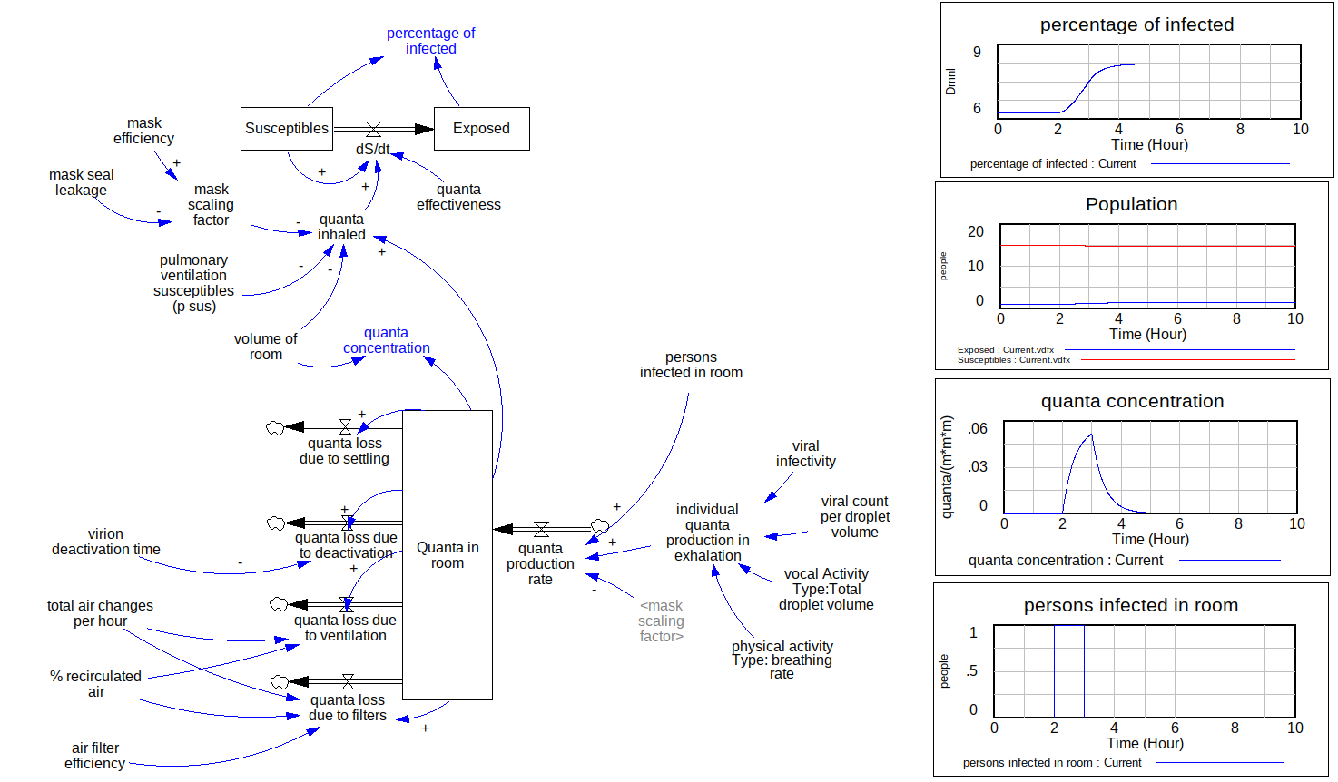
Partial Results
Pharmacy Example (Buonanno)
25 m3 room
Infected person in room for 1 hour
15 susceptibles in the room

Slide 7


Thank you
Christian Sørup,PhD christian.michel.soerup@regionh.dk
Daniel Sepulveda, PhD daniel.alberto.sepulveda.estay@regionh.dk

